Slide 1
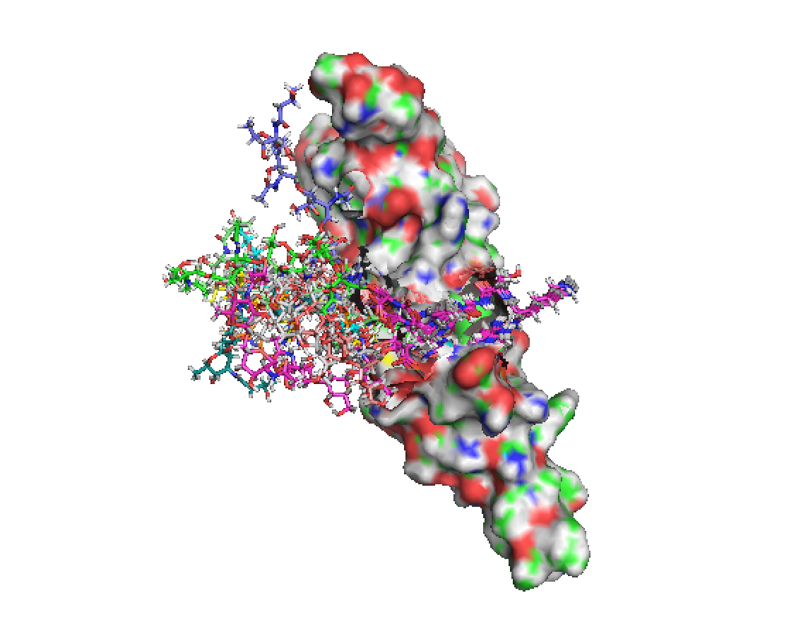
Pilus Project
Xiaotong Zuo
02/04/2016

Slide 2
Outline
Introduction of the ACICU and M2 PilA
Modeling algorithm
The low energy decoys
The H-bond, energy comparison and RMSD analysis.

Slide 3
Introduction –Pilus
Pilus
A pilus is a hairlike appendage found on the surface of many bacteria.
All pili are primarily composed of pilin proteins.
T4P are extremely thin (w60–80 A ̊ ), long (>1 mm) filaments, which can generate motile forces.
Pilin
Pilin proteins are α+β proteins characterized by a very long N-terminal alpha helix
PilA
The major pilin subunit
A. baumannii ACICU PilA. 2 disulfide bonds, one is at the C-terminus.
A. nosocomialis M2 PilA. single disulfide bond, not at the C-terminus.
Headgroup
C
N
Notes:
All pilins contain an N-terminal signal sequence
followed by a ~30-residue hydrophobic α-helix resembling a transmembrane domain, (the α1-N domain,)
which is in turn followed by a soluble ~15 kd globular domain referred to as the pilin headgroup;
the hydrophobic helical regions are buried together in the center of the fiber,
while portions of the C-terminal headgroup are exposed .
6. the major pilin is highly variable, which may avoid detection by the host immune system. glycosylation is another source of variability in some Type IV pilins

Slide 4
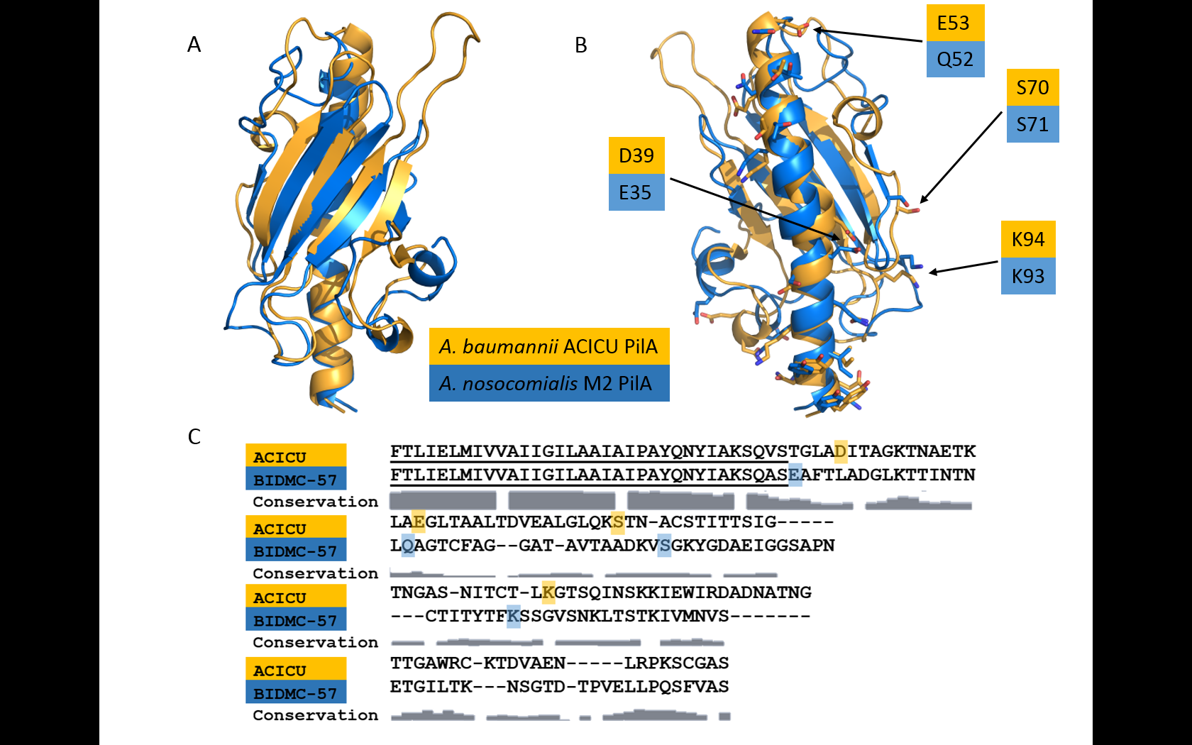
ACICU and M2 PilA
Notes:
1. we created models of A. baumannii pilus fibers from ACICU and M2 PilA based on the N. gonorrhoeae pilus.
2. beginning with alanine 23, a sequence identity of only 33% between the ACICU and M2 headgroups. many chemical moieties(functional groups) can be found in similar positions (Figure 4B), are not obvious from a sequence alignment. Which indicates that pilins may be assembled through similar networks of non-covalent interactions.

Slide 5
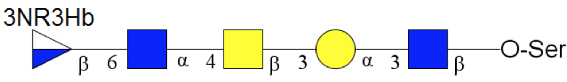
ACICU
Modeled the monomer of ACICU.
Tail: resi 132-139, 8 aa
R P K S C G A S
Sugar: resi 140-144, 5 resi
GlcNAc, Gal, GalNAc, GlcNAc, Qui(3RHb)
Tail
132-139
Sugar
5 4 3 2 1

Slide 6
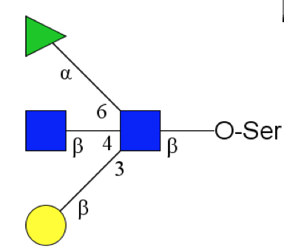
M2
Modeled the dimer of M2.
Tail: resi 121-136, 16 aa
Sugar: resi 137-140, 4 residues
Tail
121-136
Sugar
4 Rha
1 GlcNAC
3 Glc
2 Gal

Slide 7
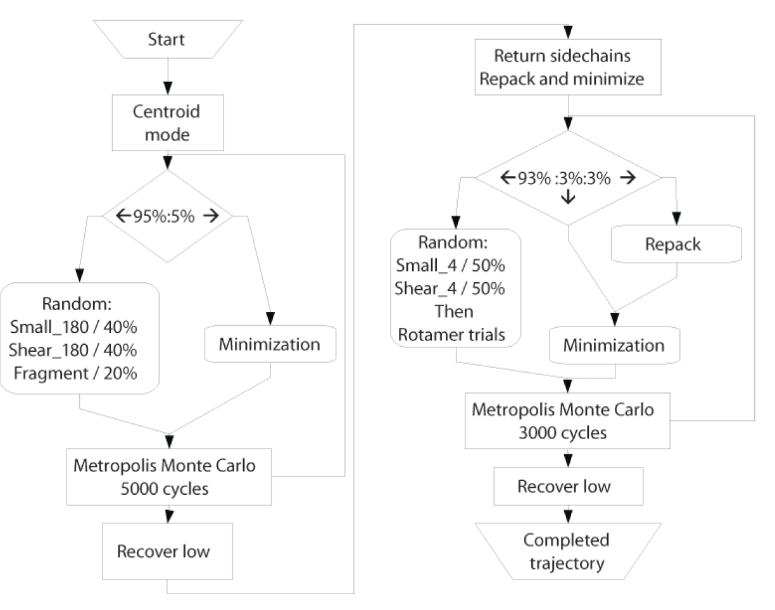
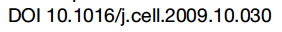
Algorithm

Slide 8
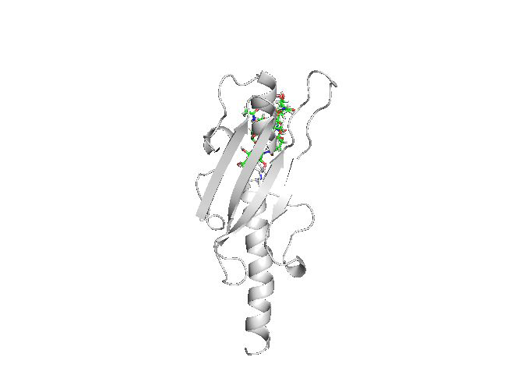
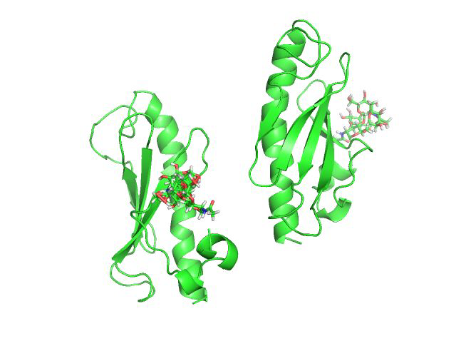
Algorithm

Slide 9
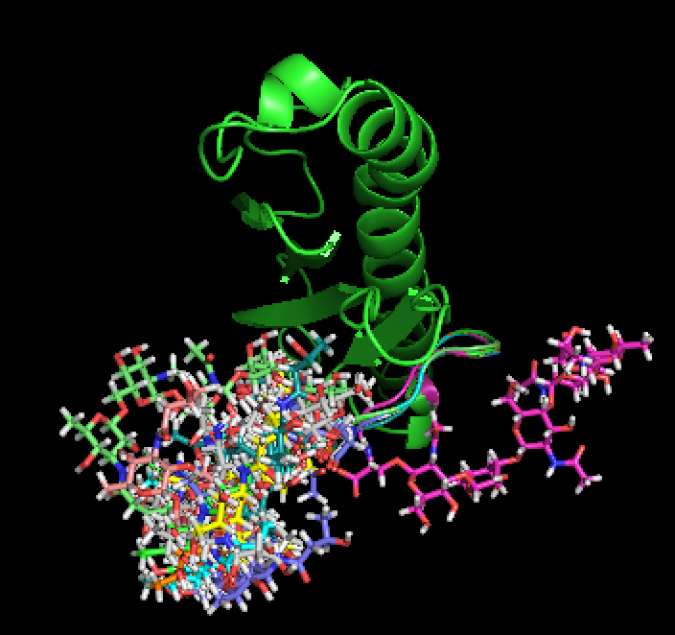
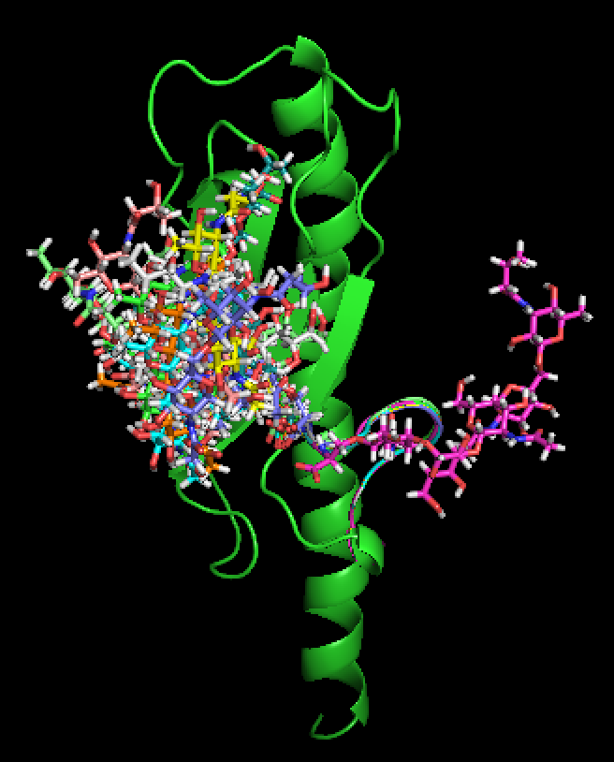
ACICU—Top 10 lowest score decoys
4200 decoys of ACICU monomer.
Scores range from -96.23 to -78.88.
Rha

Slide 10
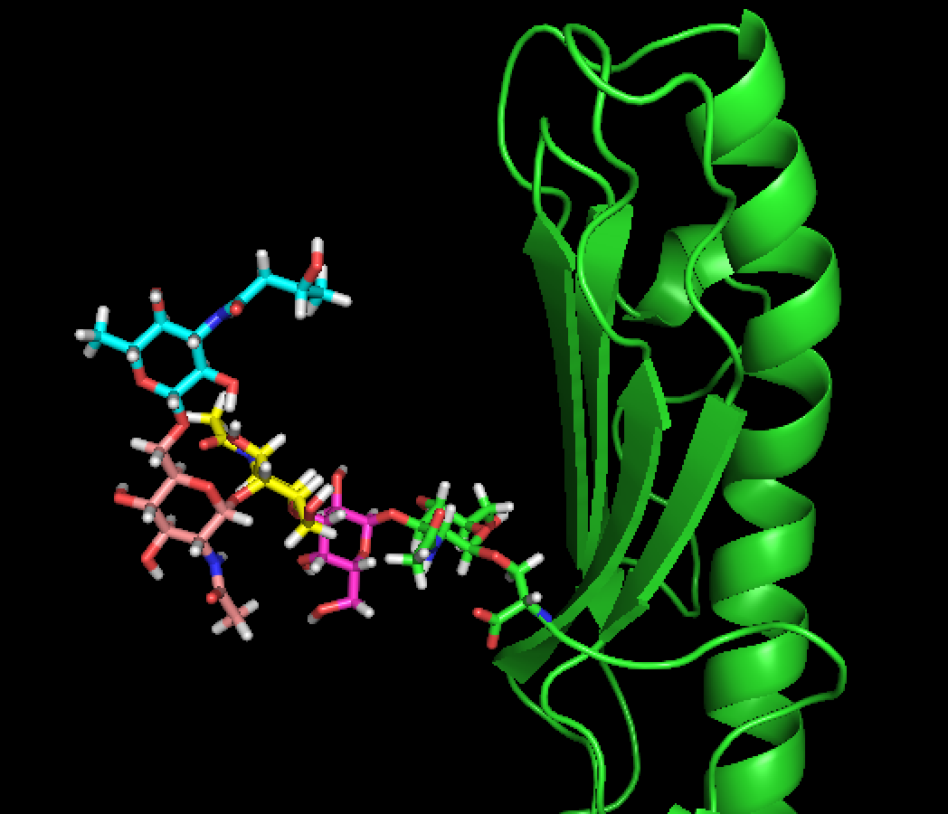
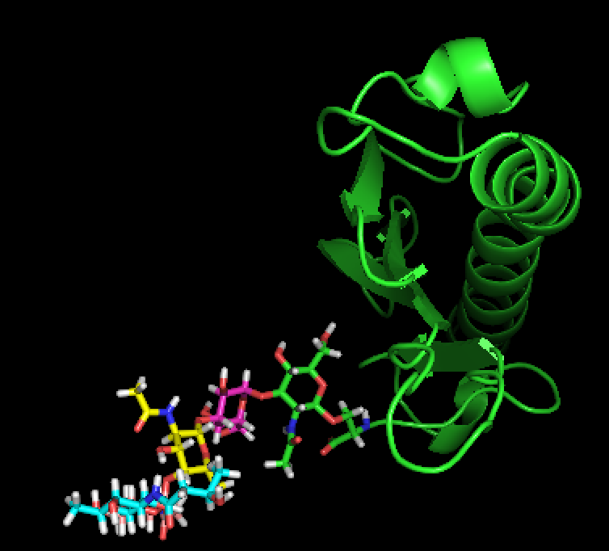
ACICU—Lowest Score Decoy

Slide 11
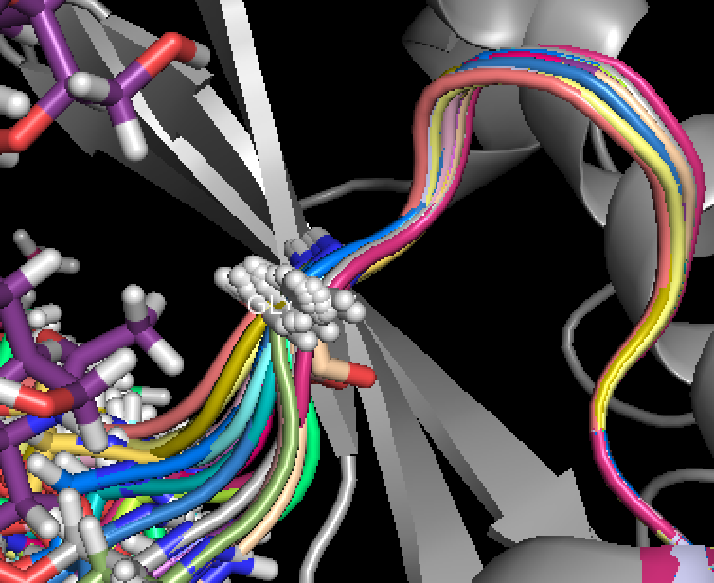
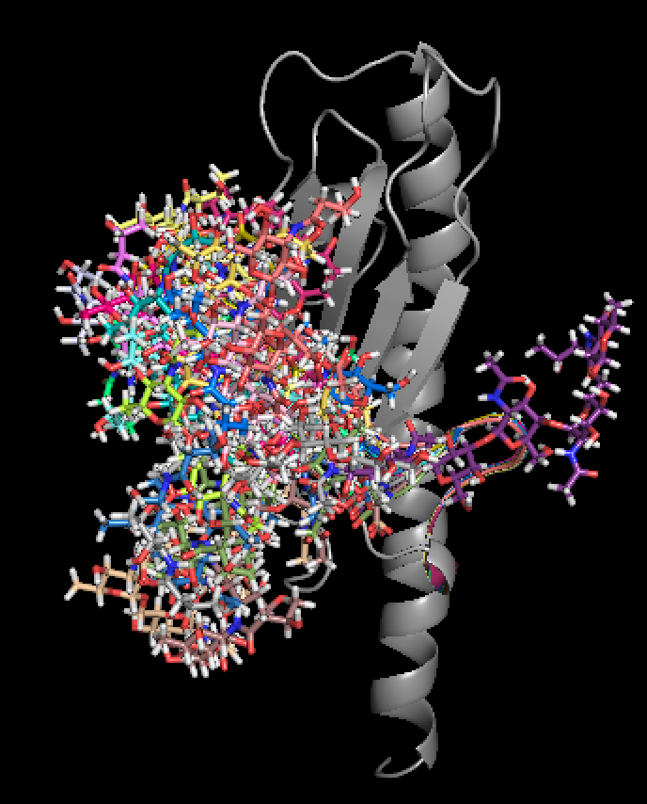
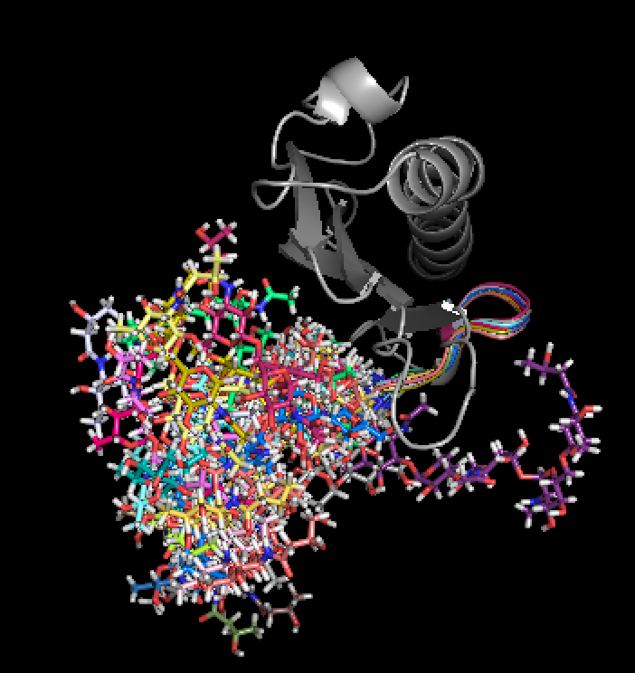
ACICU—20 Random Decoys
Front View
Top View

Slide 12
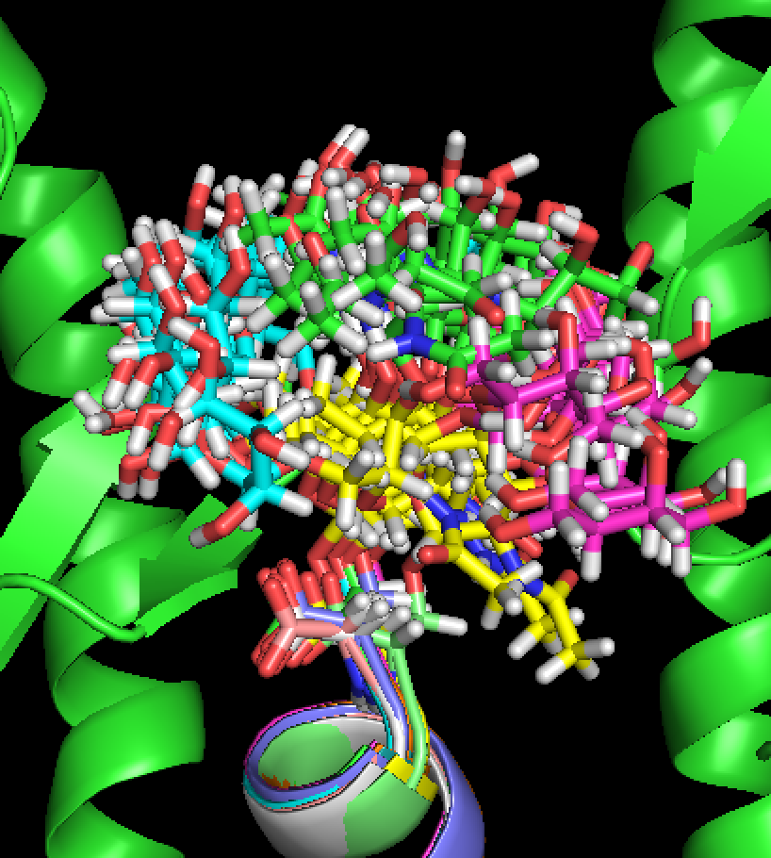
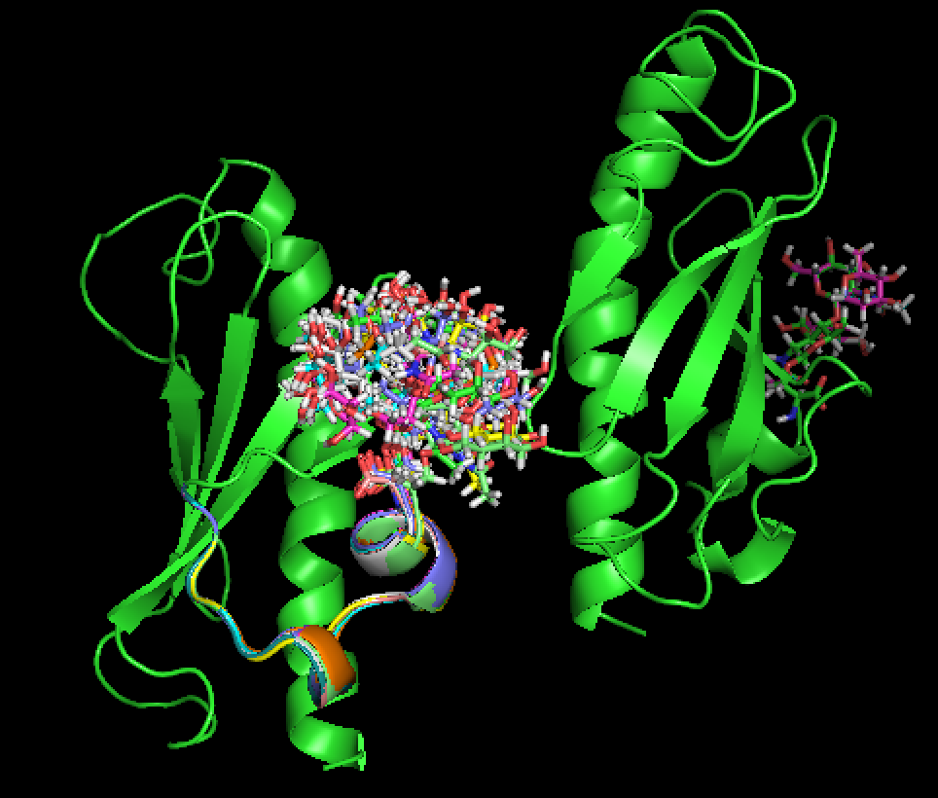
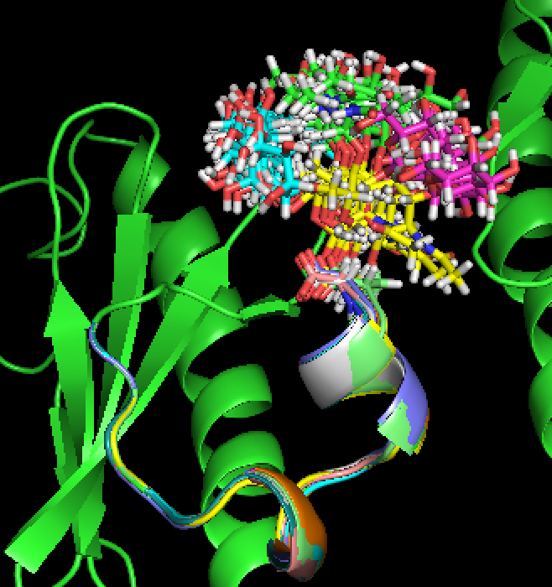
M2—Top 10 lowest score decoys
3000 decoys of M2 dimer.
Scores range from 167.13 to 181.94.
Glc
Rha
Gal
Glc

Slide 13
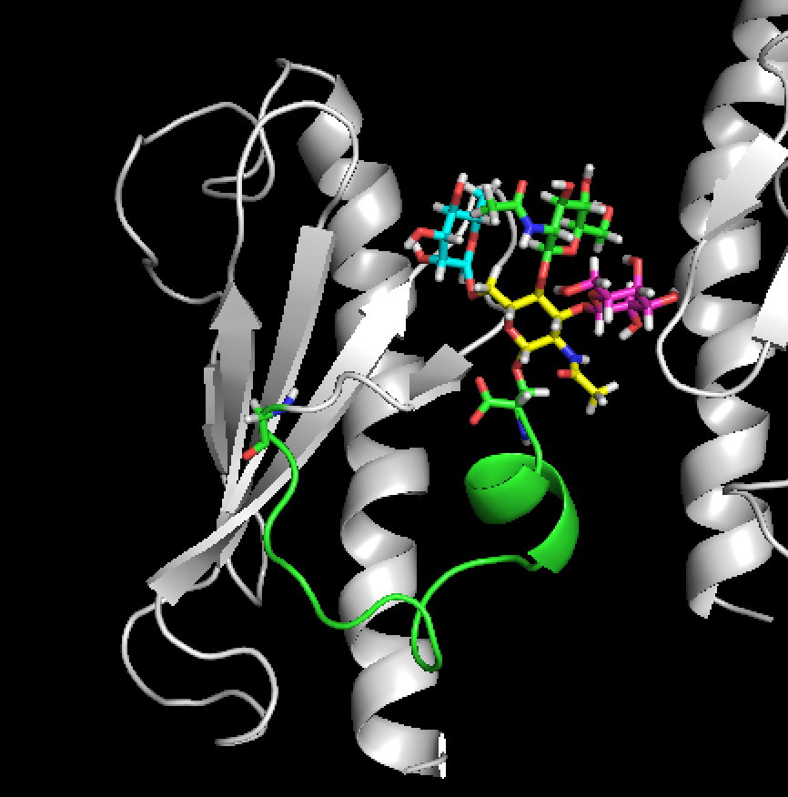
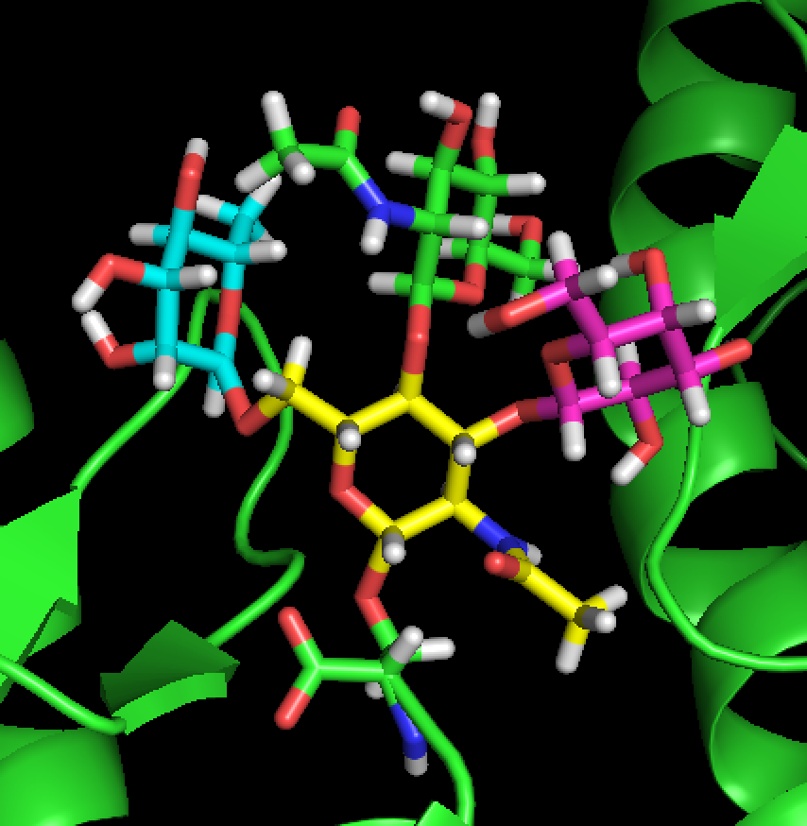
M2—Lowest Score Decoy

Slide 14
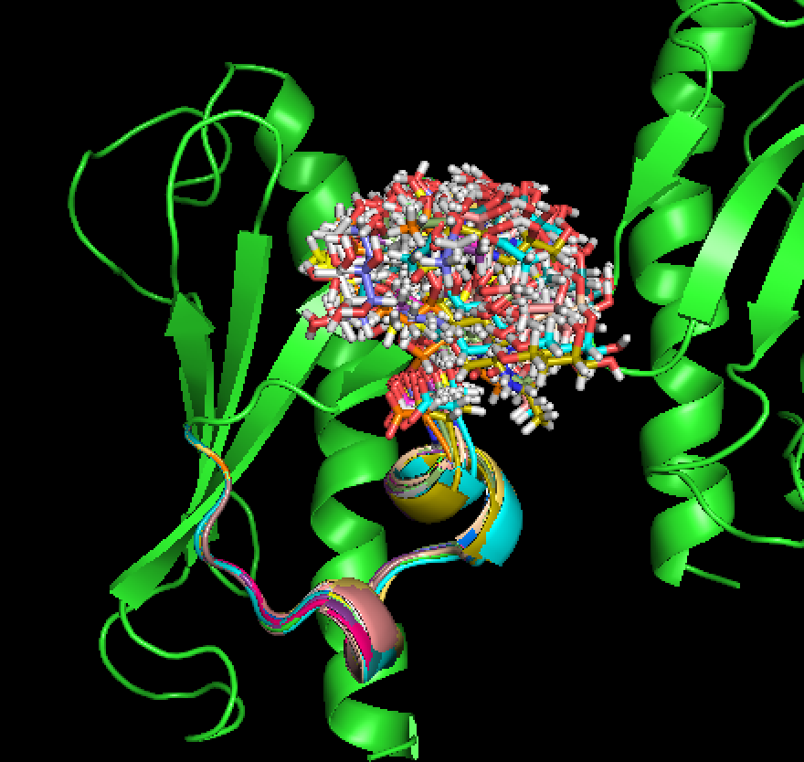
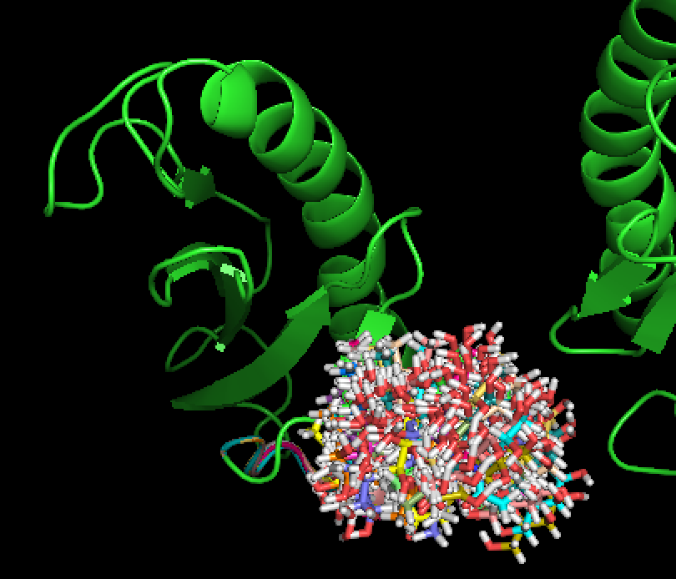
M2—20 Random Decoys
Front View
Top View

Slide 15
Discussion – H-bond
Notes:
Tail aas are stable
M2 is more stable than ACICU, and less hbond at sugar region
M2 has Hbond with the headgroup of the other chain

Slide 16
Discussion – H-bond
Glc
71 Ser
Rha
Glc
Gal
Gal
Glc
Glc

Slide 17
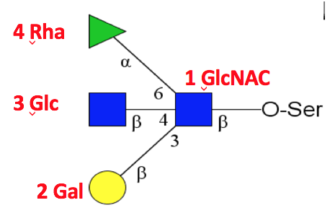
Residue by Residue Score Comparison
Tail
132-139
Sugar
5 4 3 2 1
ACICU
M2

Slide 18
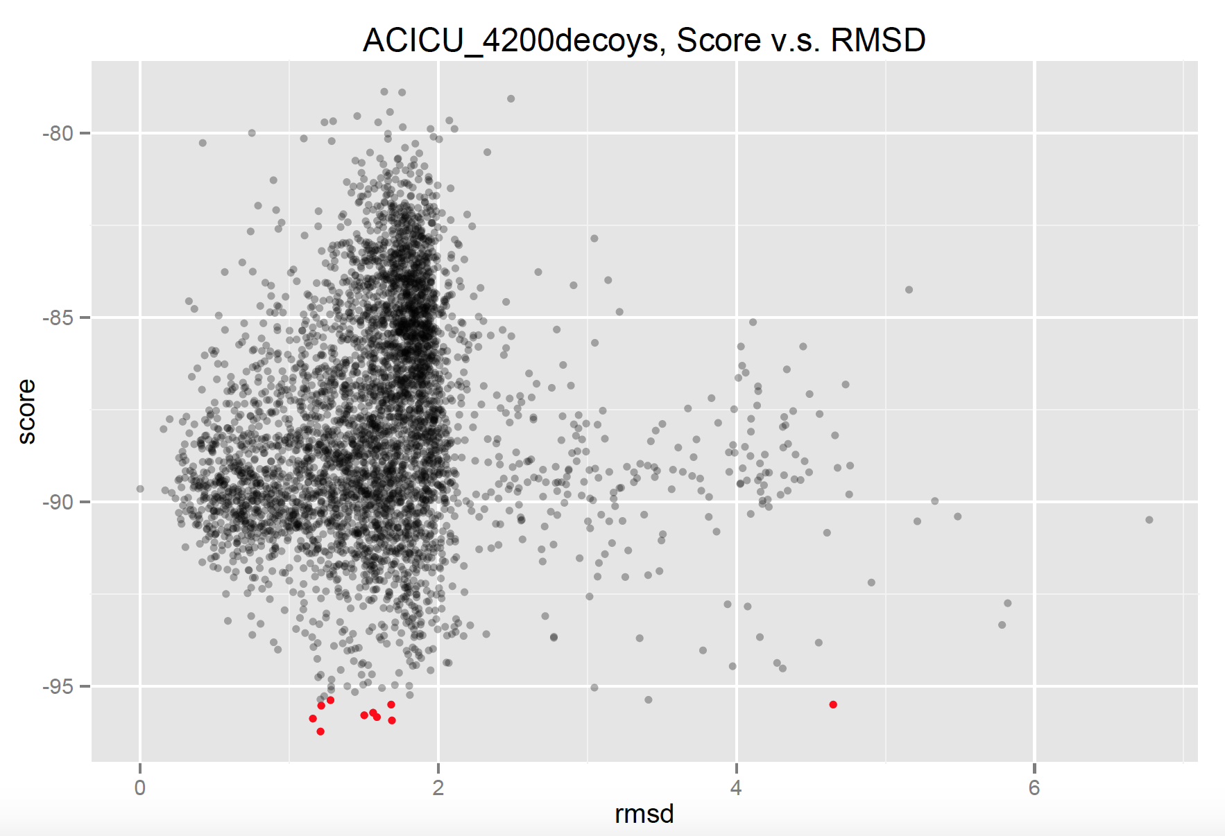
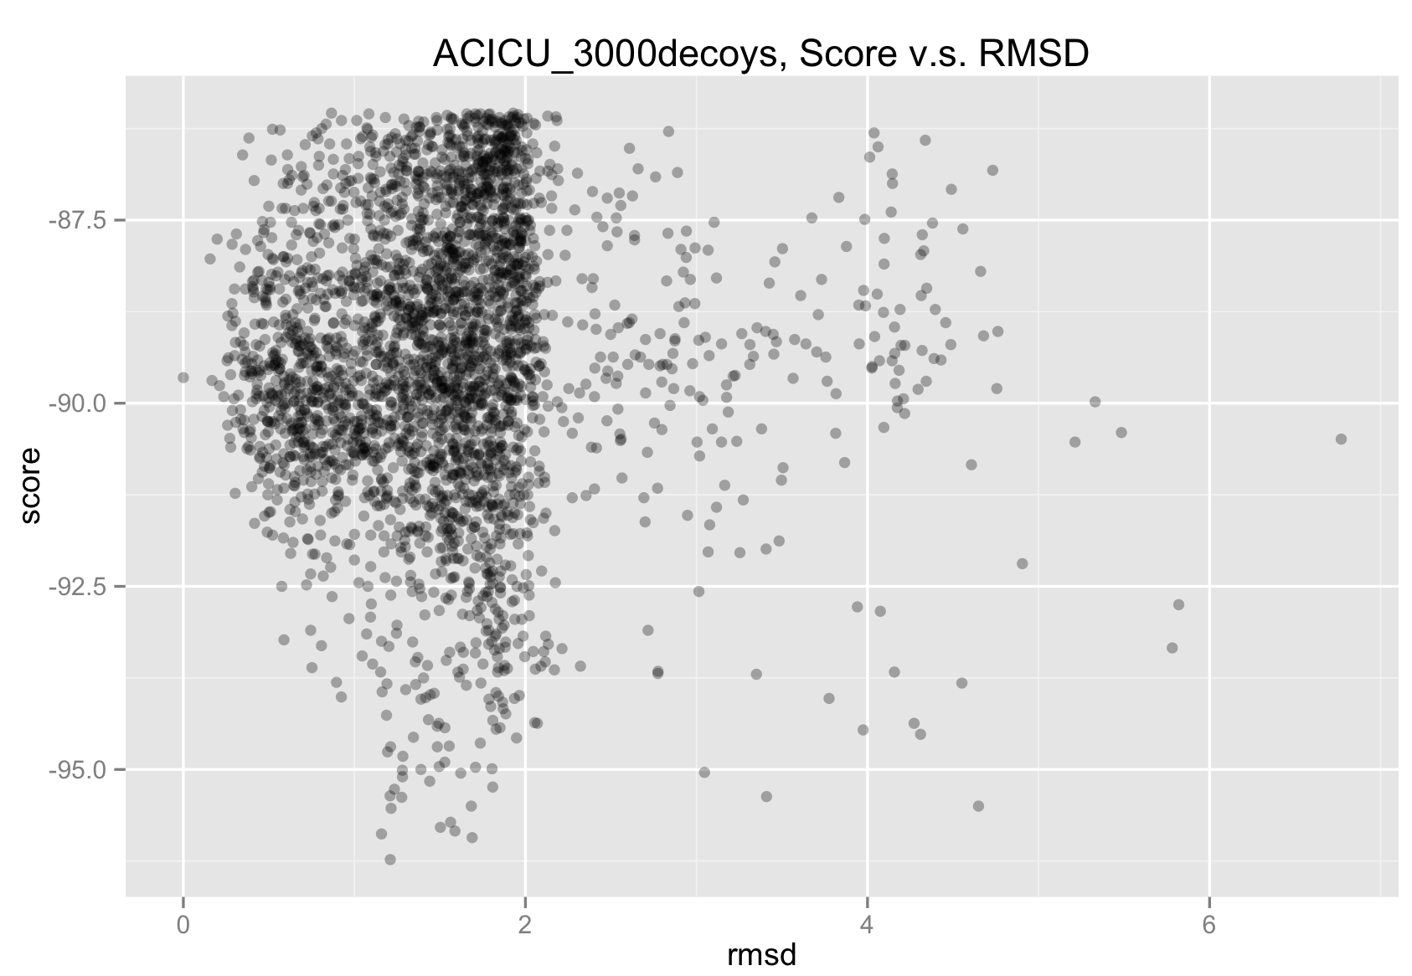
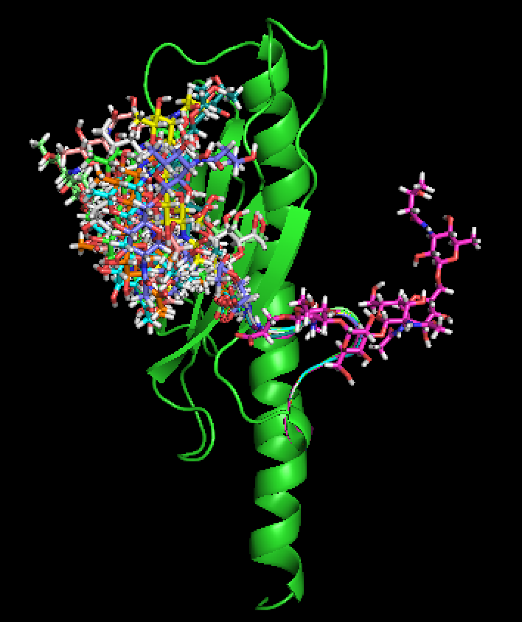
RMSD—ACICU
RED: Top 10 decoys

Slide 19
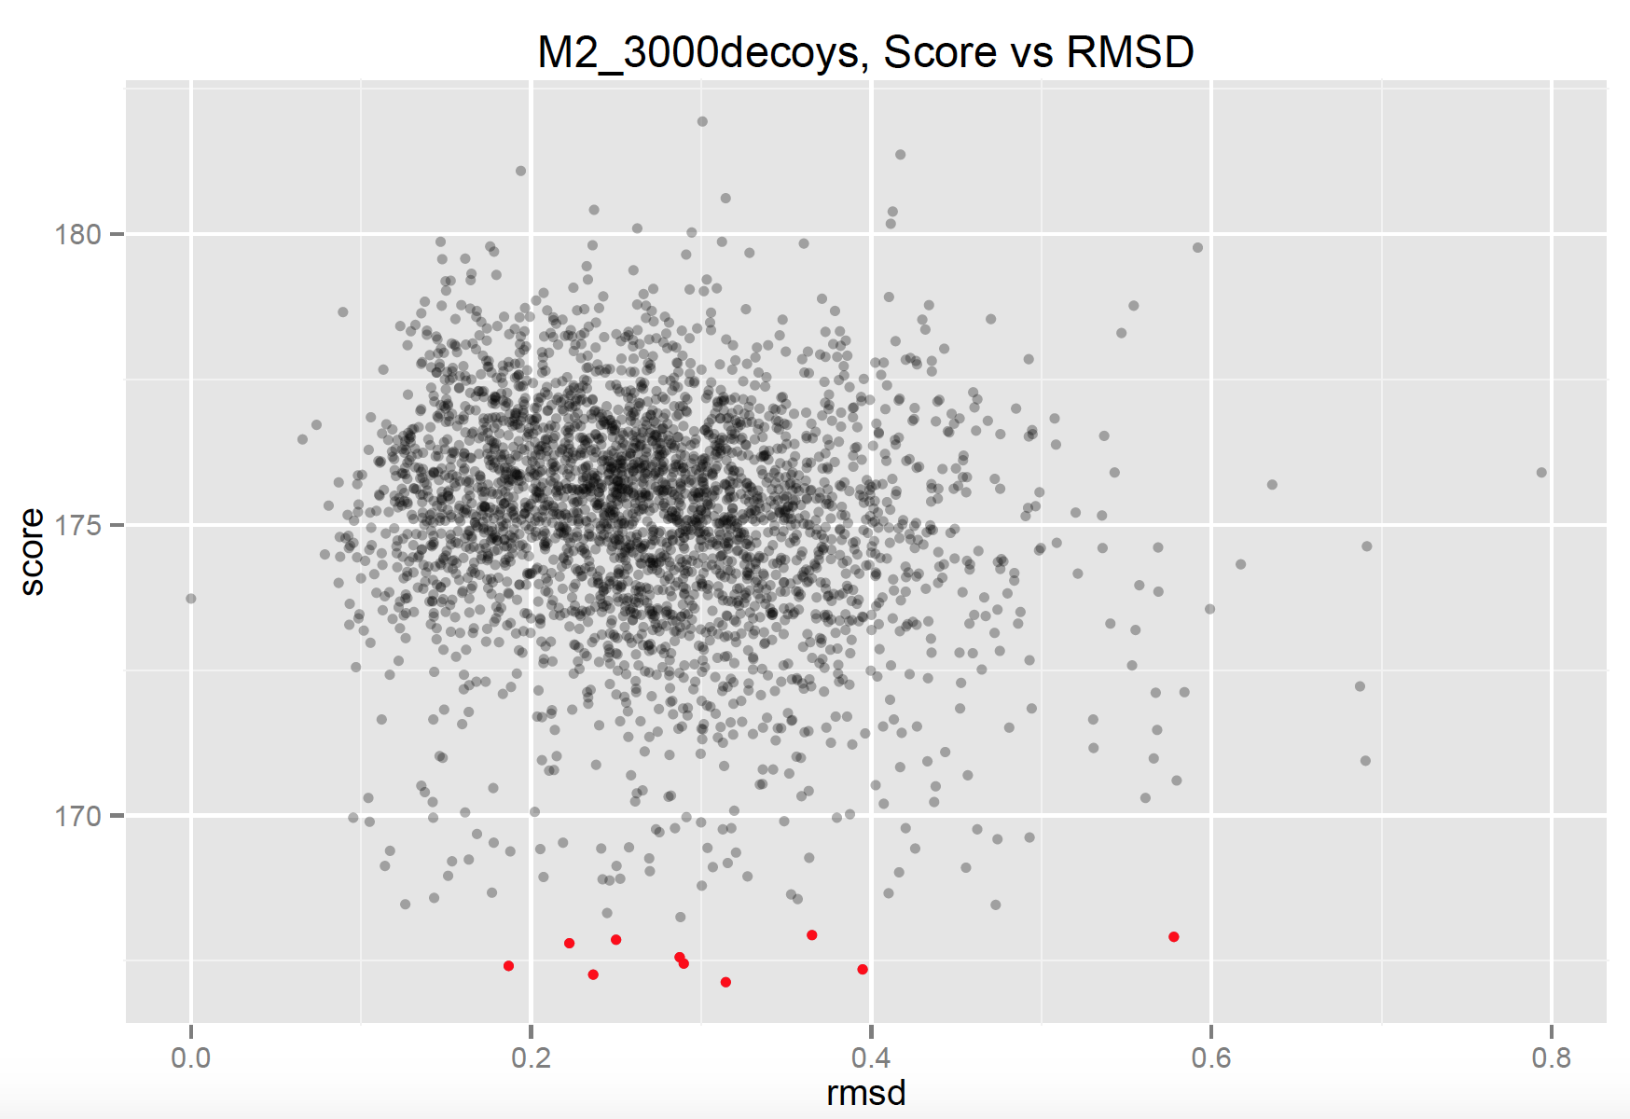
RMSD—M2
RED: Top 10 decoys

Slide 20
Energy Contribution
Total Score of Tail and Sugar Regions |  |  |  |  | Reference
Rank | File # | Total score Tail+Sugar | Tail Score | Sugar Score | Total score without sugar | Total score with sugar
1 | 54 | 8.15706 | 2.237612 | 5.919448 |  | -93.40
2 | 46 | 10.227974 | 2.07028 | 8.157694 |  | -91.34
3 | 75 | 12.147614 | 2.439046 | 9.708568 |  | -90.88
4 | 48 | 12.655672 | 3.547386 | 9.108286 |  | -90.39
5 | 72 | 14.401064 | 3.343786 | 11.057278 |  | -90.14
6 | 25 | 13.609306 | 3.043458 | 10.565848 |  | -89.34
7 | 52 | 12.78331 | 1.642136 | 11.141174 |  | -89.25
8 | 80 | 14.723172 | 3.586684 | 11.136488 |  | -88.63
9 | 53 | 16.05306 | 1.177782 | 14.875278 | -104.98 | -88.06
10 | 77 | 17.281564 | 3.20227 | 14.079294 |  | -85.22
Sugar chain has a greater contribution to the total score changes.
Tail region is more stable than sugar. In different decoys, the scores of tail are very similar to each other.

Slide 21
Thank You!

